Slide 1
Last chance
Simple game

Slide 2
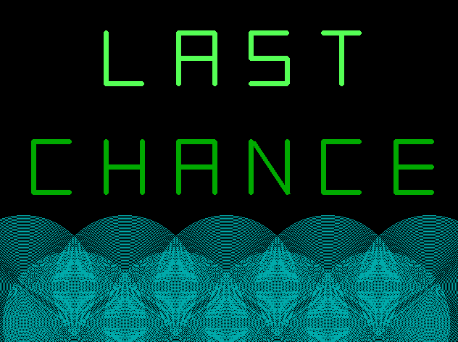

Slide 3
Purpose
Since long time ago, we play this game with small ball in nature. This game need only two player. So, if there is only one player, it cannot be play. So, I wanna write a game project which bases on this game. Now I have finished this game project not all exactly finished. I have to update this game project again.

Slide 4
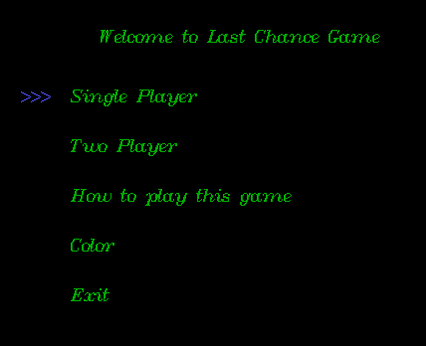
Last chance

Slide 5
Explanation
We can use up, down, left and right cursor.
If we choose single player, we can play it only and there will be level we can choose.
Besides if we choose two player, we can play with our friends.
If we choose how to play, there is rules to play it.
If we choose color, there will be 15 different colors to choose.
If we choose exit, we will leave this game program.

Slide 6
How to play
This is a two player game. If we choose single player, we play with computer. First we will roll dice, and we can decide who will play first. There are three groups in this game. If first player play first, second player fills the bubbles at most 20 bubbles in each group. Then first player has to select one of these groups. After that he has to remove at least one bubbles. And then, this is second player turn. Like first player did, select group and remove the bubbles. Next first player turn again. He also has to select group and remove the bubbles. Repeating the sequence, at last, we have only one group. The one who removes the last bubble or bubbles, must be a loser.

Slide 7
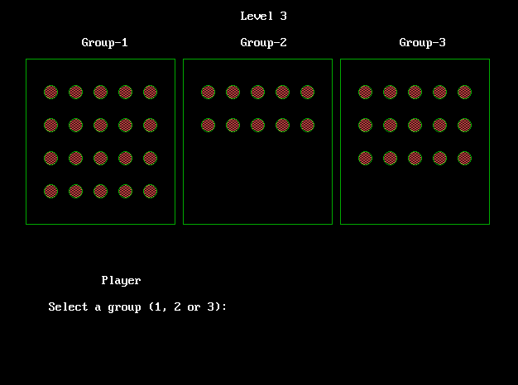
How to Play
Here, there is three groups and ask which group do you want to choose .
And then it will also asked for how many bubbles do you want to remove.

Slide 8
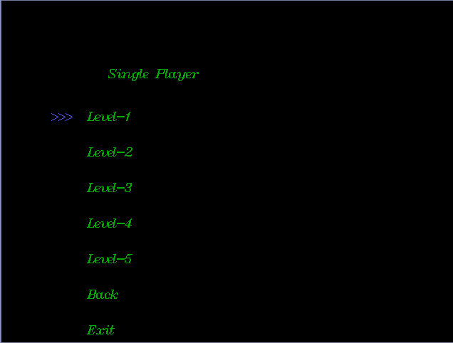
Single player
If we enter “Single Player“, this screen will be appeared. In this screen, we can choose level and go to back screen. If we choose exit, we will leave this screen.

Slide 9
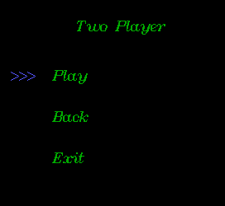
Two Player
If we choose “Two Player”, this screen will appear. In there, we will choose play and go to back.

Slide 10
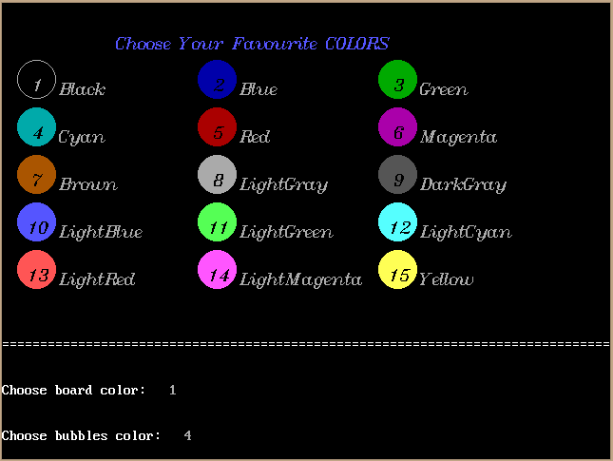
Color
If you choose “Color”, we can choose these colors.

Slide 11
Thank you
For your Attention
Presented by Hnin Htet Htet

